Slide 1
Forecast by Sector
(Week 40-Week 44)
Prepared by: Nur Syarfa Shafina Binti Nor Elley
Division: NPE
Date : 15 November 2022

Slide 2
Table of Contents
1 | Actual Data
2 | Actual Data (More Insight)
3 | Forecast Data
4 | Forecast Data(display hover)
5 | Forecast Data: Show as Table
6 | Insight
7 | Dashboard Sample
8 | Dashboard Pin Live
9 | Power BI (Link)

Slide 3
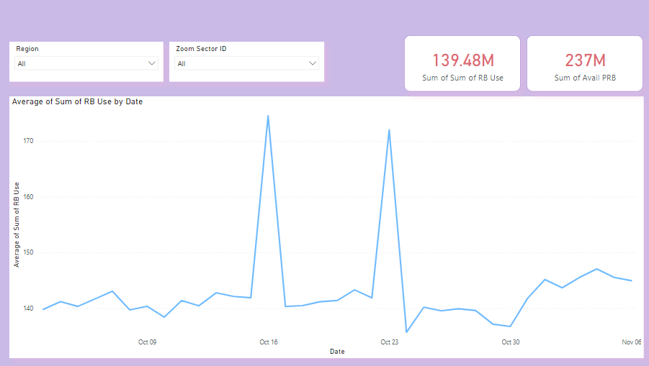
Actual Data (Week 40-Week 44)
Card (Sum of RB Use)
Slicer (to filter by Region)
Card (Sum of Avail PRB)
Slicer (to filter by Sector)
Line plot (actual data)
Line chart: Sum of RB Use by Month

Slide 4
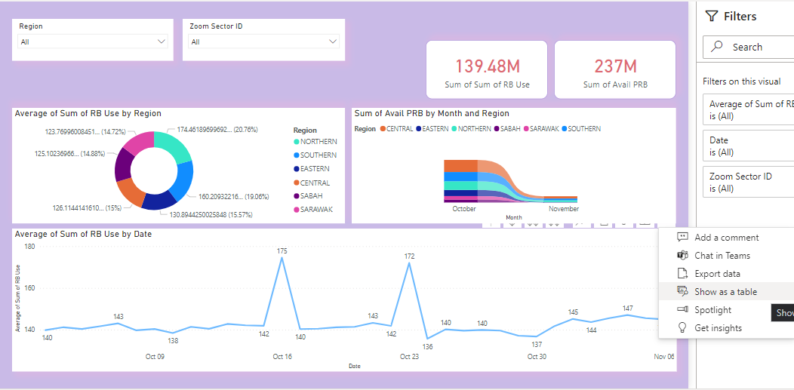
Actual Data (More Insight)
Donut charts: Visualized the avg of sum of RB Use by Region
Ribbon charts: Visualized the sum of Avail PRB by Region
More option button: to show chart as table to display value details

Slide 5
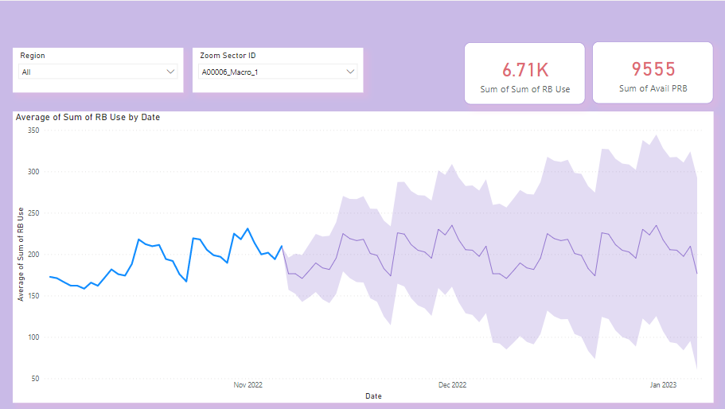
Forecast Data – by Sector (Week 40-Week 44)
Card (Sum of RB Use)
Slicer (to filter by Region)
Card (Sum of Avail PRB)
Slicer (to filter by Sector)
Upper bound (forecast data)
Line plot (forecast data)
Line plot (actual data)
Lower bound (forecast data)
Line chart: Sum of RB Use by Month

Slide 6
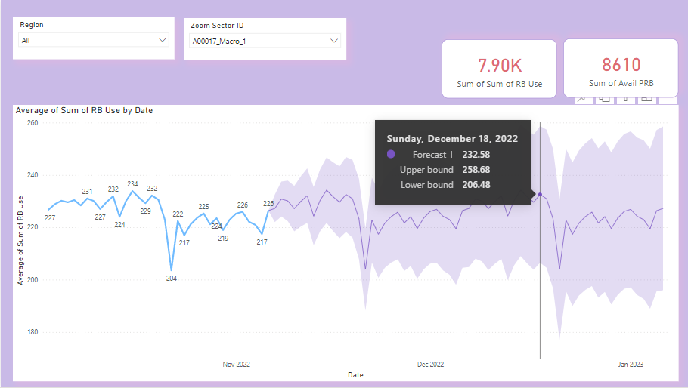
Forecast Data(display hover)
Hover
Move the cursor to the points in the charts to display hover and details values

Slide 7
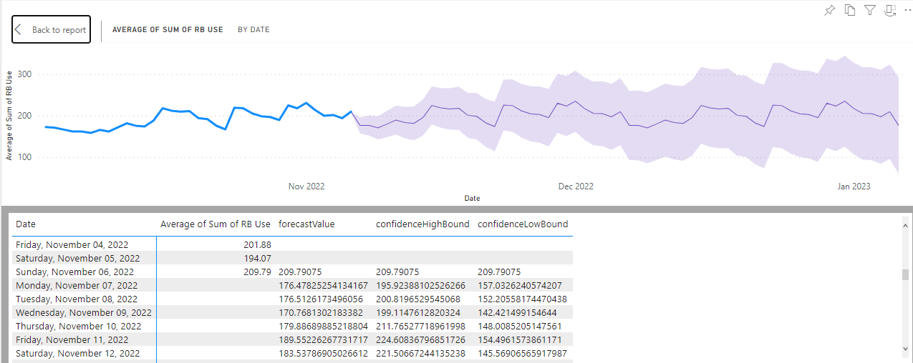
Forecast Data: Show as Table
Table: display the details of the line charts which consist of forecast value, confidence high bound and confidence low bound

Slide 8
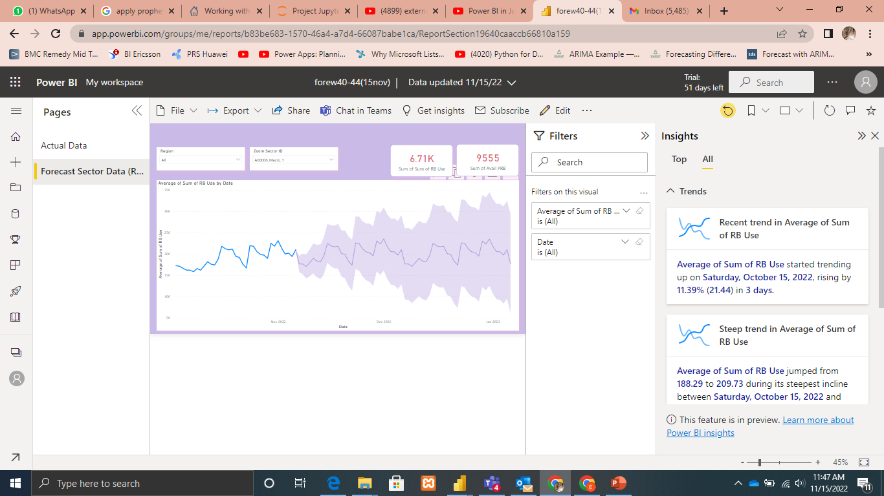
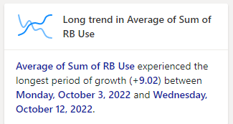
Insight

Slide 9
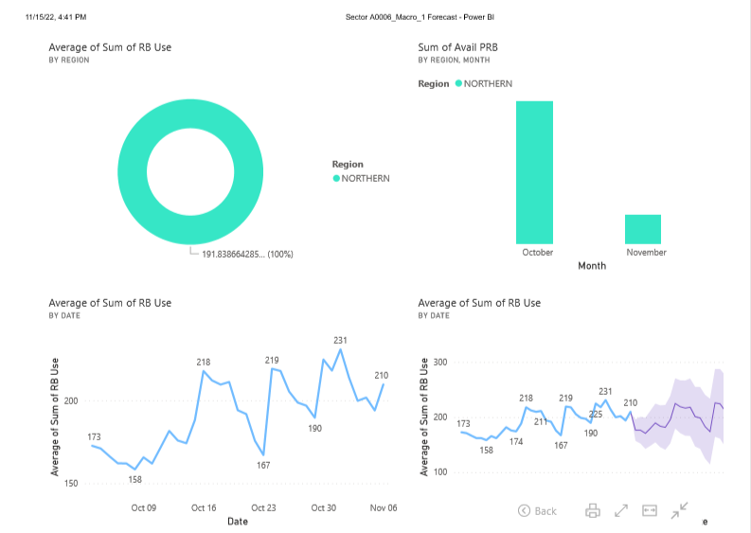
Dashboard Sample (A00006_Macro_1)

Slide 10
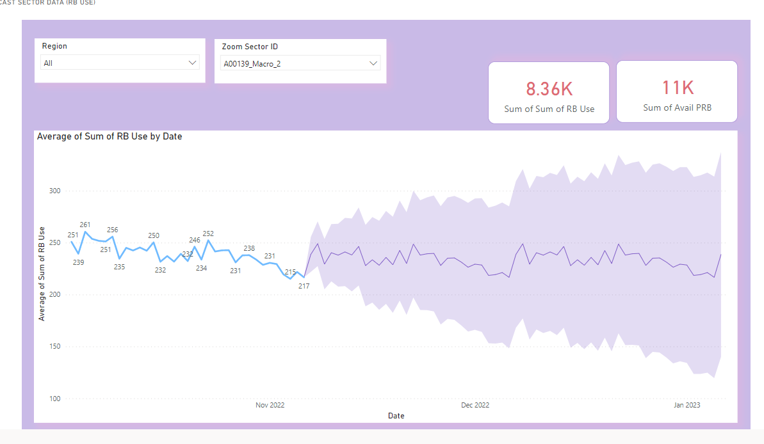
Dashboard Pin Live (A00139_Macro_2)

Slide 11
Power BI (Link)
Report link:
https://app.powerbi.com/links/EAzRtqEhCM?ctid=bf048976-7110-4e87-96f3-c6744908b8be&pbi_source=linkShare&bookmarkGuid=dfd80800-d084-4d17-847a-2e8e2fb52461
Dashboard link:
https://app.powerbi.com/groups/me/dashboards/601a98ae-a24a-4b6a-adbc-945a4dac7011?ctid=bf048976-7110-4e87-96f3-c6744908b8be&pbi_source=linkShare

